Slide 1
Health and Safety in Experimental Labs

Slide 2
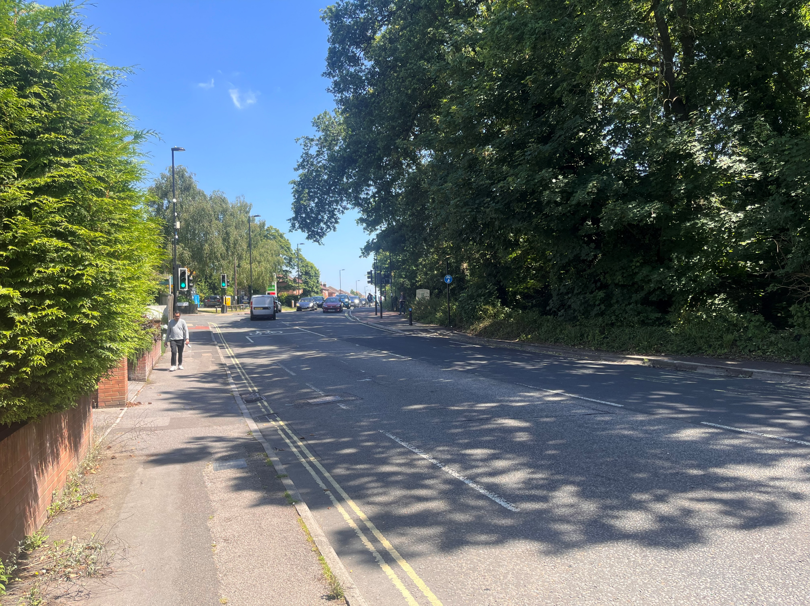
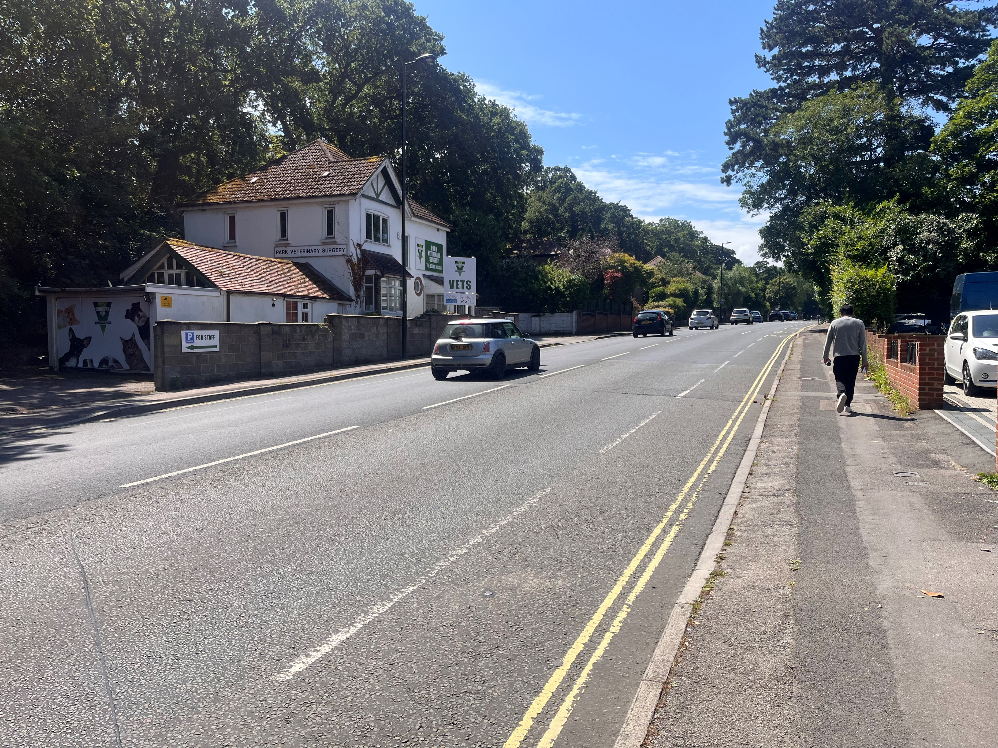
Crossing a Road
Notes:
How do you decide whether to cross? Do you worry about falling over when crossing? What if I asked you to cross a motorway? How could you make crossing safer?
Final conclusions. You do an assessment of risk all the time. It is mostly common sense and a bit of knowledge. Someone taught you to cross the road because the consequences of not doing so were too great. Before you were able to understand the risk you weren’t allowed to cross the road alone.

Slide 3
Proposition
Everyone wants to go home after doing an experiment unharmed and without doing harm to anyone else
Agree or Disagree ?
Notes:
You say you Agree now but people don’t always act accordingly. Imagine you are in a hurry to get your dinner and the safe option is slower. What do you do then?

Slide 4
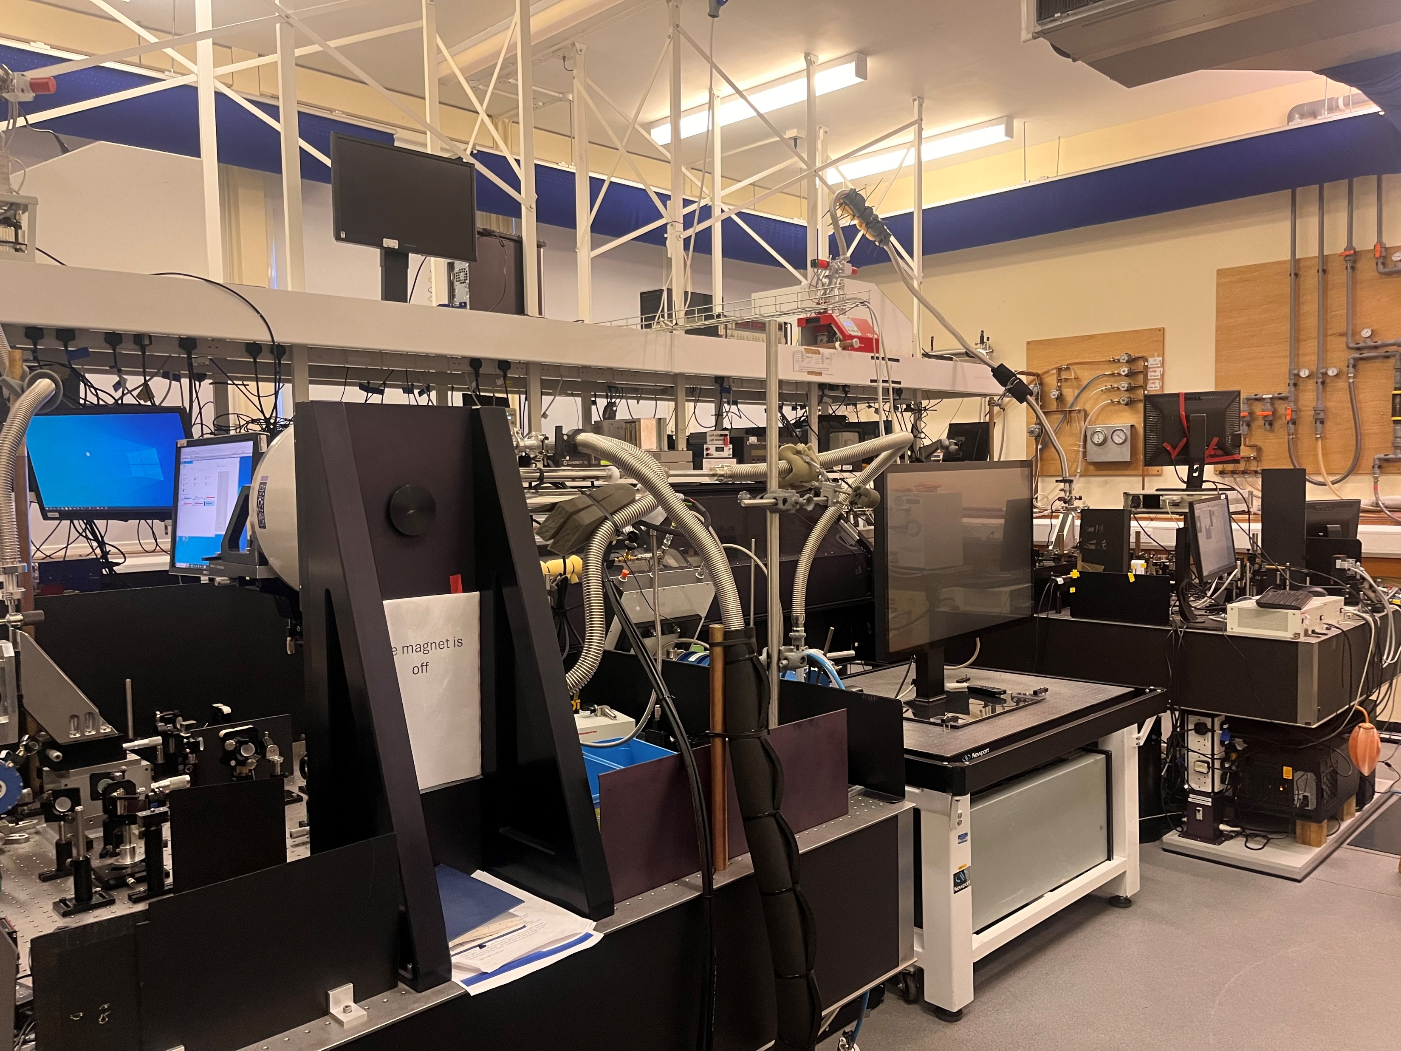
What are the hazards in this lab?
Notes:
You probably didn’t spot them all as you are not familiar with this environment. It is your responsibility to become familiar with the risks and manage them to keep yourself and others safe.

Slide 5
Observations
Experimental laboratories can be dangerous and even lethal places
People work in experimental laboratories every day without harm and whilst incidents do occur, they are not common.

Slide 6
How can we reconcile these observations?
Scientists
are aware of the risks associated with their experiments
design their experiments to reduce the risks.
undertake them in ways to reduce the risks.
don’t do an experiment if it would be too risky.
Notes:
Maybe the last should be first but the aim is to do experiments safely not to stop all experiments because some of them could be unsafe.

Slide 7
Health and Safety Law
You and everyone you work with has a legal obligations to ensure the safety of themselves and others around them.
You cannot delegate that responsibility down or up.
If you think something is unsafe, or could be unsafe, you have a legal responsibility to act.
A risk assessment is part of doing things safely and having a ‘suitable and sufficient’ risk assessment is a legal obligation
Notes:
Obviously, other people also have a responsibility. What you are responsible for depends on your part in the process. e.g. the VCs responsibility is different from yours.
The correct attitude and common sense are much more important than precisely how the paperwork is filled in. If you have taken all reasonable steps to make something safe that doesn’t mean a freak accident can’t happen.

Slide 8
Assessing the Risks – a Risk Assessment
Before you do any work in a lab or other unfamiliar environment you need to think through the risks.
Doing this formally means you are less likely to make a mistake and more likely to find all the risks.
The piece of paper on which a risk assessment is written never saved anyone.
The thought process of risk assessment saves many people.
No Thought means No Risk Assessment

Slide 9
How to Assess Risk – 5 Steps
What, how & who: Identify hazards/ hazardous event/ who could be harmed
Evaluate risk
Identify controls
Record
Review
Notes:
What is the hazard, How does harm occur & who does it harm.
Evaluate Risk, and how to control it,
Record and review

Slide 10
How to assess risk - hazards
A Hazard has potential to cause harm (injury or ill health)
A Hazard event is when the hazard causes harm (or has the potential to).
A Hazard consequence is the nature & extent of the harm caused by the hazard event.
Notes:
A laser is a hazard - A laser contacting a persons skin is the hazard event - A burn is the hazard consequence

Slide 11
How to Assess Risk - Who
Who could be harmed?
User, those nearby, those in the vicinity, the public.
Don’t forget visitors & cleaners
New & expectant mothers, young persons and disabled persons have particular requirements.

Slide 12
What is risk assessment?
Risk
=
Likelihood x Impact
Notes:
Risk is an exposure to danger
likelihood of that exposure
multiplied by the impact of that exposure

Slide 13
How to Assess Risk - Evaluate
Inherent risk – evaluation of risk without ANY controls.
Residual risk - evaluation of the risk with controls in place.
Notes:
Emergency contact:
For any emergency at the university call university security. 3311 from any university phone or +4423 8059 3311 form a mobile. Please take a minute to put this in your phone.
Any time you require any of the emergency services please make sure you use the University emergency number 3311. This is really important. IF you decide to dial the national UK emergency number 999 you will get through to the national switchboard and although they may know where Southampton University campus is, they have no idea where you might be on the campus! We have had ambulance drive round for 20 minutes trying to find a building.
If you dial 3311 from any University phone you get through to the local emergency switch board, this is run exactly the same as any emergency switch board, the call will be answered within 3 rings, all staff are trained and will put into place the University Emergency action plan. This will consist of giving you all the assistance you need and ensuring the emergency services find you as quickly as possible. Local security will also react and be with you in the shortest time possible to give whatever assistance they can.
It is an invaluable service that works really well and should be used every time there is an emergency.

Slide 14
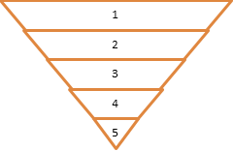
Control Measures
Use control measure hierarchy
Eliminate | Remove the hazard wherever possible which negates the need for further controls | If this is not possible then explain why
Substitute | Replace the hazard with one less hazardous | If not possible then explain why
Physical controls | Examples: enclosure, fume cupboard, glove box | Likely to still require admin controls as well
Admin controls | Examples: training, supervision, signage
Personal protection | Examples: respirators, safety specs, gloves | Last resort as it only protects the individual
Notes:
Crossing the road
Bridges
Pedestrian crossings
Lighting
Crumple zones.
Air bags
Training
Helmets

Slide 15
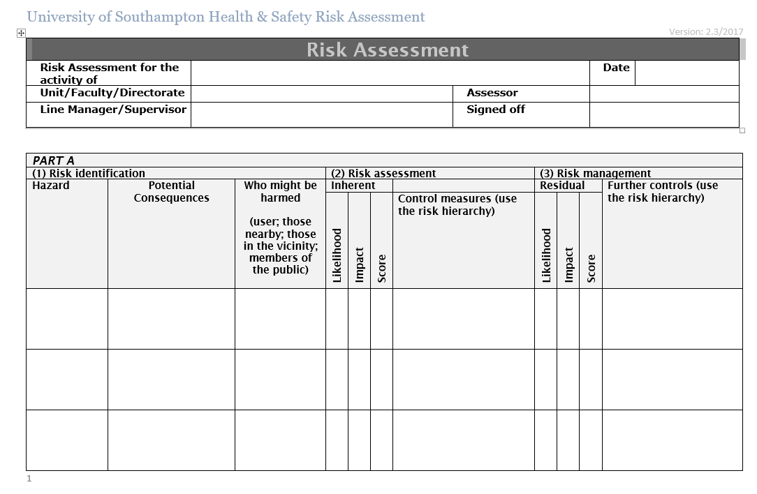
The Approved Way to do a Risk Assessment
Paperwork
Notes:
What is the activity we are assessing? Doesn’t have to be on one piece of paper. Different aspects could be on different forms. Being in a lab. Doing a specific thing in a lab for instance could be different forms. General risk assessment of a process could be modified or added to for a specific instance.

Slide 16
Risk Matrix
LIKELIHOOD | 5 | 5 | 10 | 15 | 20 | 25
 | 4 | 4 | 8 | 12 | 16 | 20
 | 3 | 3 | 6 | 9 | 12 | 15
 | 2 | 2 | 4 | 6 | 8 | 10
 | 1 | 1 | 2 | 3 | 4 | 5
 |  | 1 | 2 | 3 | 4 | 5
Impact
Red – Don’t proceed until risk reduced.
Orange - possible to proceed but further control measures should be implemented to reduce risk if possible
Green – may proceed.

Slide 17
How to Assess Risk - Review
Risk assessments must be reviewed at least annually
Risk assessments must be reviewed when the work changes
Risk assessments should be reviewed after an incident, accident or near-miss

Slide 18
Near Misses or Other Concerns
Reporting near misses/concerns isn’t about getting someone, or yourself, told off.
It is part of ensuring you and others are safe.
Imagine you failed to report a near miss and next time it didn’t miss.
Notes:
Add mechanism for reporting.

Slide 19
Conclusions
Health and Safety at work is about ensuring that people go home unharmed.
Achieving this requires some active effort from everyone including you.
The paperwork is there to help and remind you of your responsibilities not to trip you up. Pun intended.

Slide 20
Reporting Incidents

